Slide 1
Project on
Automatic Railway Gate Controller with High Speed Alerting System
Sk. Md. Zubayer-Al-Mahmud
Student ID: 1017311014
Course Name: Embedded System Design
Course Code: 5307

Slide 2
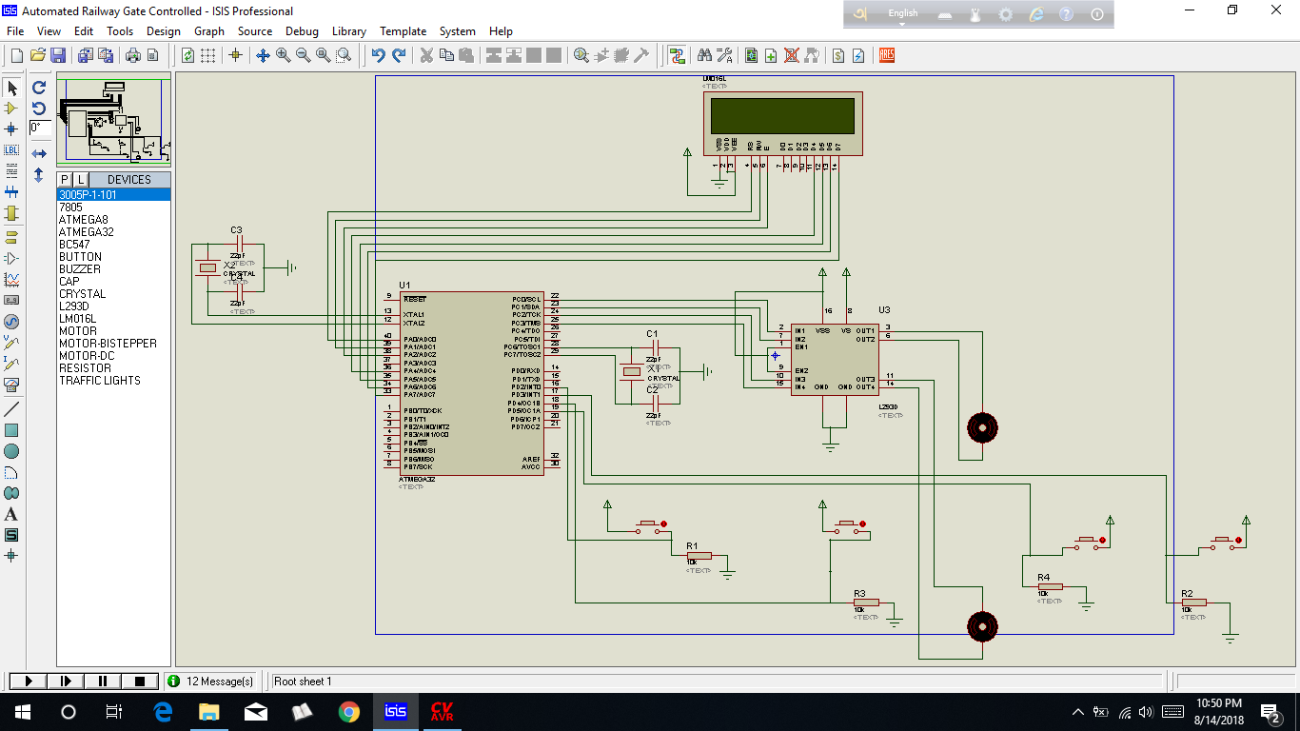
Design of the project in Proteus

Slide 3
Required Components
1. DC Geared Motors
2. pressure sensor - 4
3. ATmega32 - 1
4. crystal – 2/1
5.IC-L293D - 1
6. Registers
7.Capacitors
8. Battery
9. LCD display

Slide 4


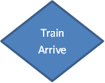

Flow chart of the program developed:

Slide 5
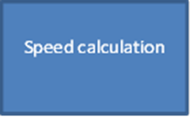

Train Departure

Slide 6
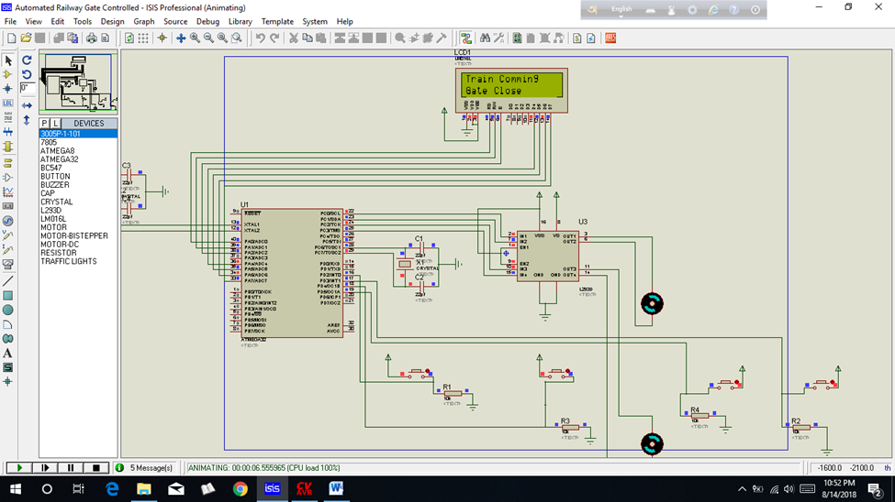
Output of the project in Proteus:
1st pressure sensor detect by pressing 1st button:

Slide 7

2st pressure sensor detect to speed calculation by pressing 2st button:

Slide 8

last pressure sensor detect to gate open by pressing last button:

Slide 9
Thanks You

